Slide 1

How I saved 80% on my Azure Data Factory Costs
Koen Verbeeck – He/him

Slide 2





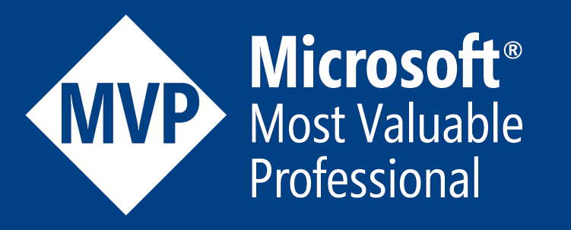
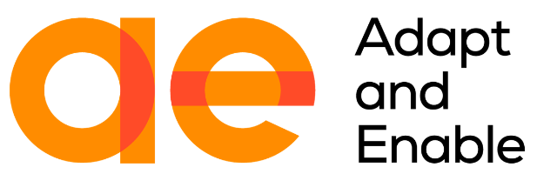
contact
Koen Verbeeck
@Ko_Ver
@koen@dataplatform.social
SQLkover.com

Slide 3
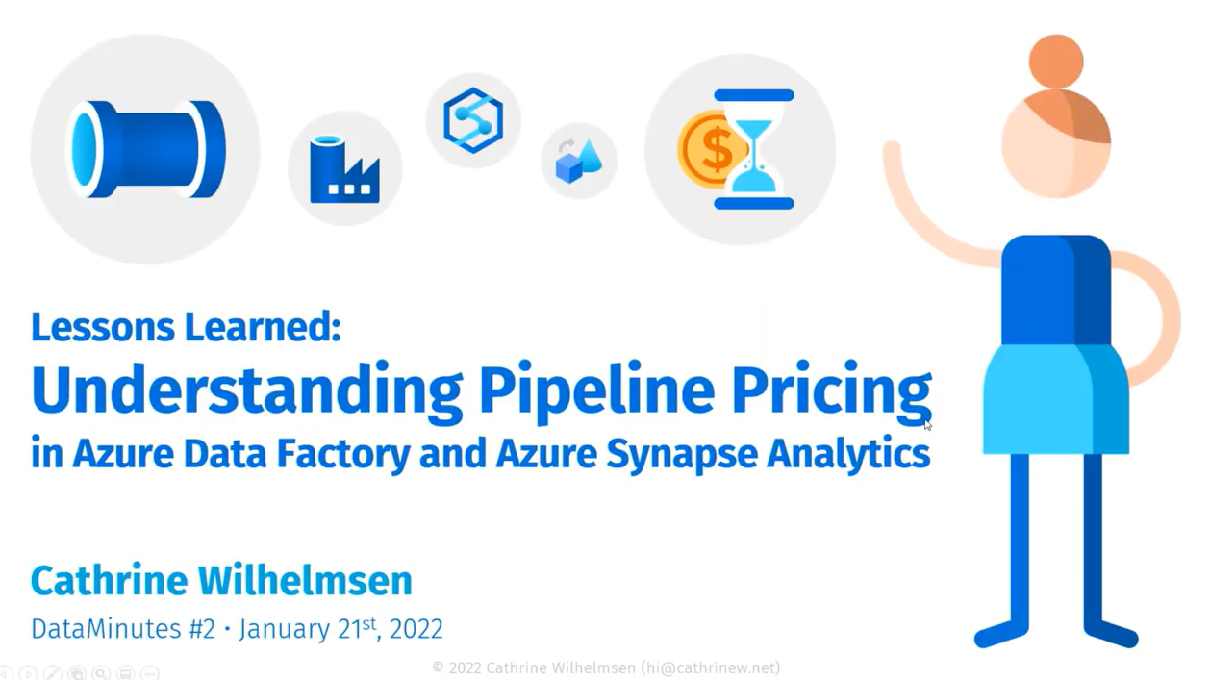
costs in ADF
https://youtube.com/watch?v=Fct1dcZMyWs

Slide 4
important to remember
ALL ACTIVITIES ARE PRO-RATED BY THE MINUTE
AND ROUNDED UP

Slide 5
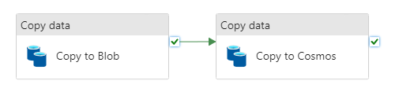
that’s 2 minutes right there

Slide 6
SSIS vs ADF
SSIS in on-premises
many up-front costs
server
license costs
cost of installing / configuring / capex
not many running costs
maintenance
development
“electricity”
it doesn’t matter how many packages you run
or how many tasks there are in a package
ADF is in the cloud
SaaS: no up-front costs
maybe a server for an on-premises integration runtime (gateway)
many running costs
mostly compute costs per minute
development
the number of activities or pipelines has a significant impact

Slide 7
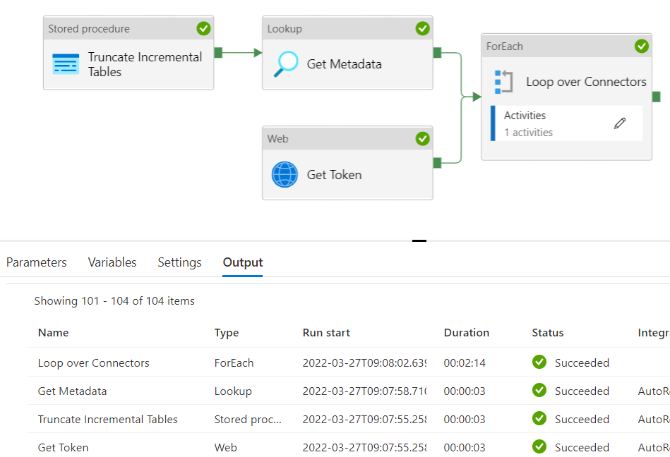
example
2 minutes and 23 seconds runtime

Slide 8
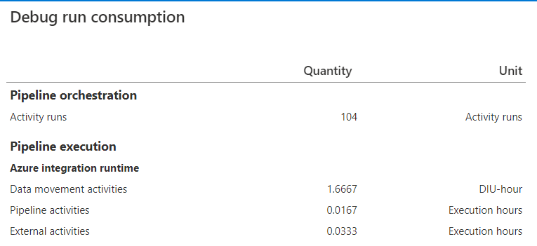
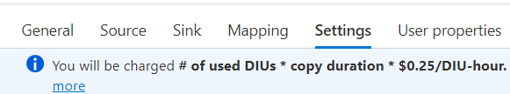
example
Orchestration (Azure-IR): $0.001/run
Pipeline (Azure-IR): $0.005/hour
$0,0000835/run
External (Azure-IR): $0.00025/hour
$0,000008325/run
Data Movement (Azure-IR): $0,25/hour
→ 2 * 1.6667 * $0.25 = $0,83335/run
$0,834441825 / run
once every day: $25.03
once every hour: $600.80
once every 5 min: $7209.58
1 minute
100 minutes!
2 minutes

Slide 9
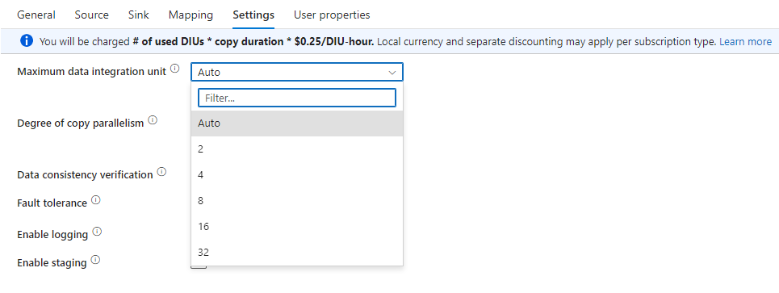
50% cost saving with one single config

Slide 10
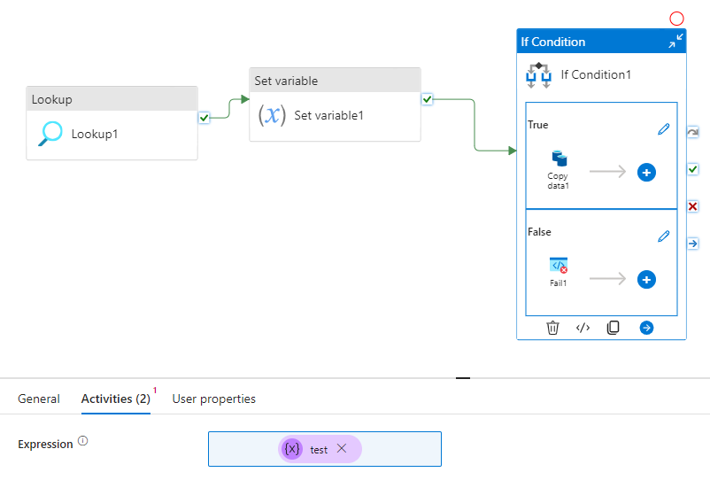

minimize number of activities
directly refer to lookup output instead

Slide 11
move compute to somewhere else
preferably to something that doesn’t have pricing per minute
such as an Azure SQL DB
scale up before ELT
scale down once ELT is done
or to compute that is just cheaper
Azure Functions or Azure Logic Apps are good alternatives
for smaller workloads
for bigger workloads, maybe consider using a self-hosted IR in a VM

Slide 12
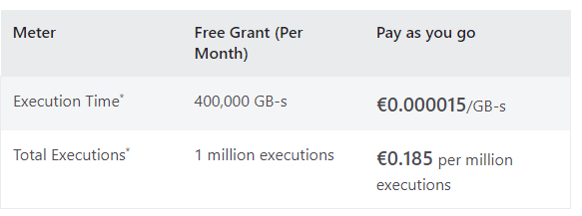

Azure Functions
don’t forget your dev costs

Slide 13
conclusion

Slide 14
conclusion
ADF is not a streaming service
you pay for each activity at least one minute
copy activity is the most expensive one
try to avoid VNET integration if it is not really needed
move compute to external options
Azure Functions
Azure Logic Apps
Databricks
SQL Server
running ADF yourself on a self-hosted IR might be cheaper
if you get ADF to be really cheap, you’re the most expensive part now ☺

Slide 15
thank you

